Slide 1
Aircraft Risk Analysis

Slide 2
Business Overview
The company is entering the aviation industry but lacks expertise in aircraft safety.
This analysis helps the Head of the New Aviation Division make informed, low-risk aircraft purchasing decisions.

Slide 3
Data Understanding
The dataset contains historical records of aviation incidents and accidents including:
Operational context (Purpose of Flight, Number of Engines)
Incident characteristics (Injury Severity, Damage, Weather Conditions)
Aircraft information (Make, Model, Engine Type)

Slide 4
Data Process steps
Loaded the dataset and installed the necessary libraries into Jupyter notebook
Looked at the overall shape and structure of the dataset.
Cleaned the dataset on a copy of the dataset which involved:
Removing duplicates
Handling missing values
Ensuring consistency across relevant variables
Performed my EDA.

Slide 5
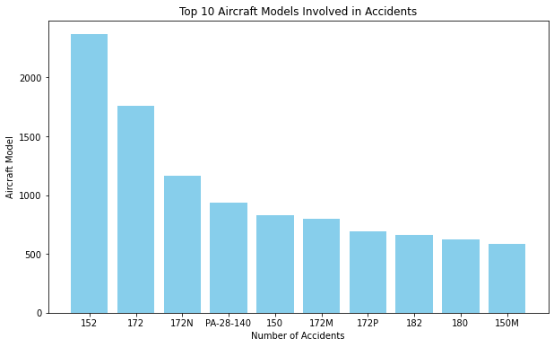
Top 10 Aircraft models and makes Involved in Accidents.
The bar chart above shows that the first 3 aircrafts models have the highest number of accidents.

Slide 6
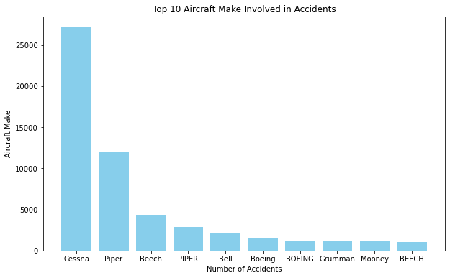
The bar chart shows that one aircraft manufacturer (Cessna) is involved in accidents far more frequently than others.

Slide 7
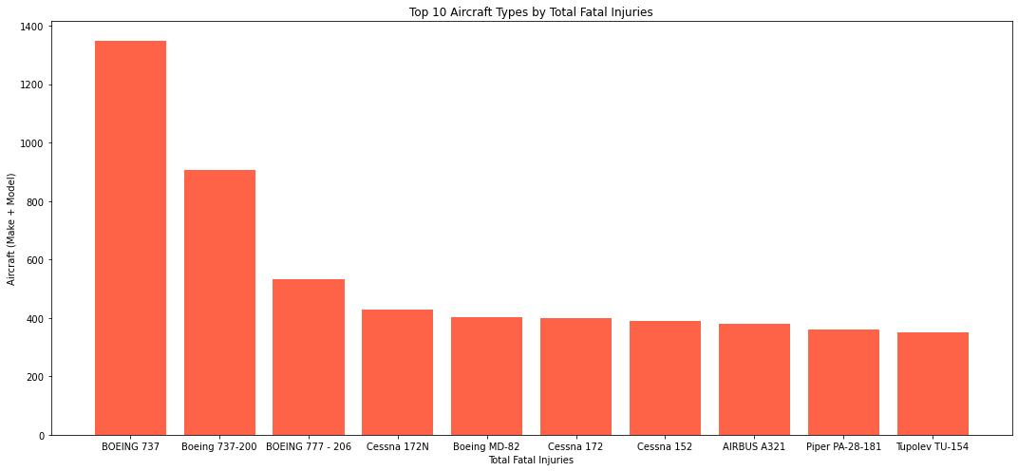
Top 10 Deadliest Aircraft Models and Make
The bar chart above shows the specific aircraft models have been associated with the highest total fatalities in accidents.

Slide 8
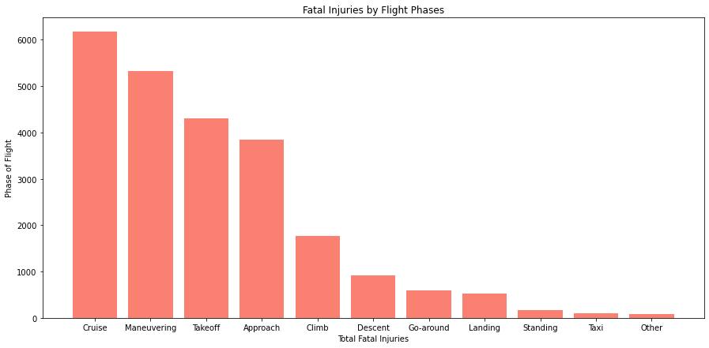
Most dangerous flight phases
The bar chart shows that certain phases – particularly Cruise, Maneuvering, Takeoff and Approach – account for the majority of fatal injuries.

Slide 9
Recommendations
Prioritize deeper safety analysis on the top 3 manufactures which are Cessna, Piper and Beech.
Conduct safety audits specifically on the top 10 aircraft types identified involved in fatal accidents
Implementation of advanced in-flight monitoring systems to detect and address anomalies early during cruises.
Focus on investigating spike years (2015, 2018) to identify root causes and apply targeted safety measures to ensure a more consistent decline in fatal accidents.

